Slide 1
University admission chatbot
Presented By:
1. Nilesh Kumar Gupta – SAMBALPUR UNIVERSITY INSTITUTE OF INFORMATION AND TECHNOLOGY – COMPUTER SCIENCE DEPARTMENT

Slide 2
OUTLINE
Problem Statement
Proposed System/Solution
System Development Approach
Result
Conclusion
Future Scope
References

Slide 3
Problem Statement
Develop a Chatbot solution to streamline university admission processes by providing personalized guidance, automating inquiries, and ensuring data security.

Slide 4
Proposed Solution
User Interaction: The chatbot engages users in natural language conversations, using prompts and responses to guide them through the admission process.
Information Collection: It prompts users to input their name, mobile number, competitive exam rank, interested courses, and Admit card details, storing this information securely.
Query Handling: The chatbot responsible for handling all the doubts and queries of student regarding the courses provided by the university.
User Guidance: It provides step-by-step guidance and all information regarding applying dates, counseling date all information regarding admission process
Feedback Mechanism: The chatbot is able to get a feedback to improve its responses and user experience over time, ensuring continuous optimization.

Slide 5
System Approach
The "System Approach" section outlines the overall strategy and methodology for developing and implementing the rental bike prediction system. Here's a suggested structure for this section:
System requirements : windows 10operating system , 8GB RAM, I3 Processor
Library required to build the model : IBM Watsonx assistant

Slide 6
Result
The development of a robust chatbot for university admission process will result in a streamlined and efficient experience for prospective students. By offering personalized guidance on admission requirements, deadlines, and program details, the chatbot will enhance accessibility to accurate information. Automation of routine inquiries and processes such as application submissions and status updates will improve efficiency and reduce administrative workload. Integration with existing university systems will ensure scalability and seamless operation during peak periods. Furthermore, stringent data security measures will safeguard personal information, ensuring compliance with regulations and enhancing trust. Ultimately, the chatbot will optimize the admission process, providing a user-friendly interface that enhances overall satisfaction and engagement for prospective students.

Slide 7
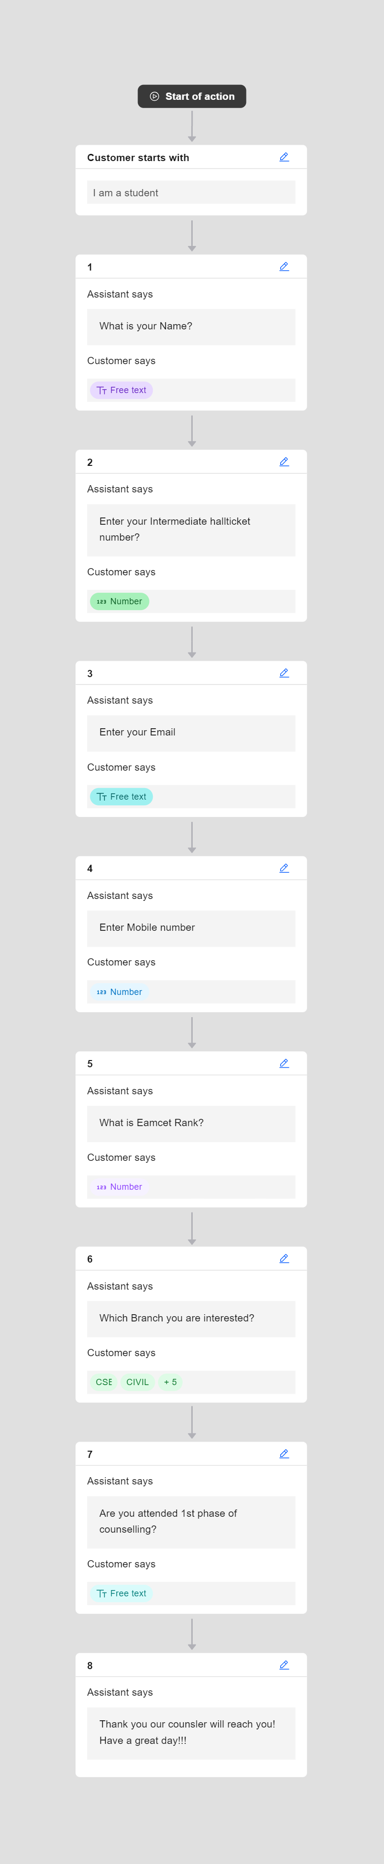
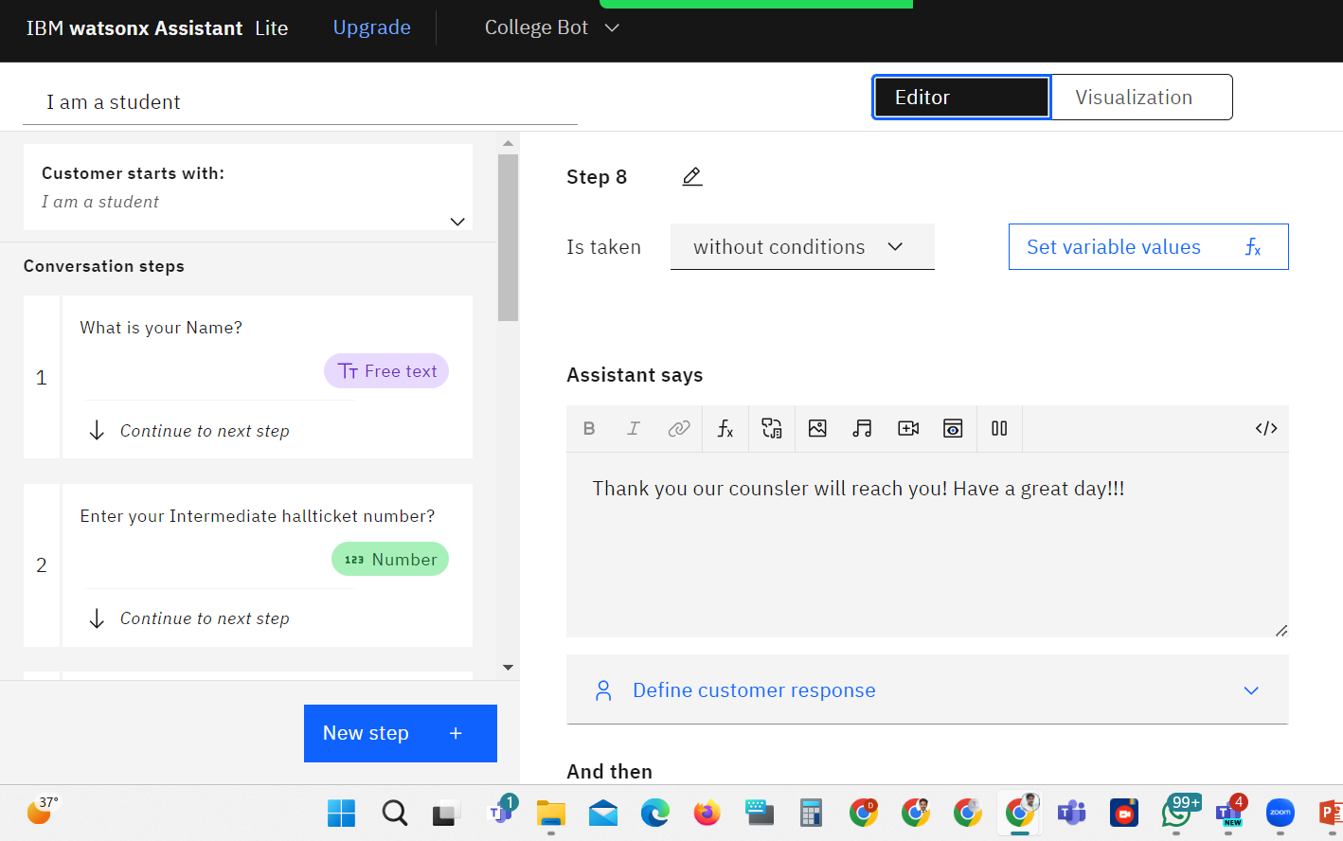
Result

Slide 8
Conclusion
In conclusion, the implementation of a sophisticated chatbot for university admission processes promises to revolutionize the way prospective students interact with and navigate through the admissions journey. By combining personalized guidance, automation of routine tasks, seamless integration with existing systems, and stringent data security measures, the chatbot not only enhances operational efficiency but also significantly improves the overall user experience. This innovation underscores a commitment to innovation and accessibility in higher education, ensuring that every student receives timely, accurate information and support throughout their admission process.

Slide 9
Future scope
The future of the university admission chatbot entails continuous evolution and enhancement to meet the dynamic needs of both prospective students and the educational institution. Moving forward, the chatbot will leverage advancements in artificial intelligence (AI) and machine learning (ML) to further refine its natural language processing capabilities, enabling more nuanced and contextually aware interactions. It will expand its scope beyond basic inquiries to offer proactive guidance, personalized recommendations, and predictive analytics to aid students in making informed decisions about their academic journey. Furthermore, the chatbot will integrate seamlessly with emerging technologies such as virtual reality (VR) and augmented reality (AR) to provide immersive campus tours and interactive experiences, enhancing engagement and recruitment efforts. Data security will remain a top priority, with continuous updates to safeguard personal information and maintain compliance with evolving regulations. Ultimately, the future vision for the chatbot is to become an indispensable assistant throughout the entire student lifecycle, supporting admissions, enrollment, and beyond, while continually setting new benchmarks for efficiency, accessibility, and user satisfaction in higher education.

Slide 10
References
IBM watsonx Assistant tutorial

Slide 11
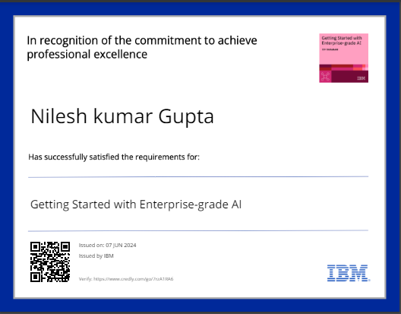
course certificate 1

Slide 12
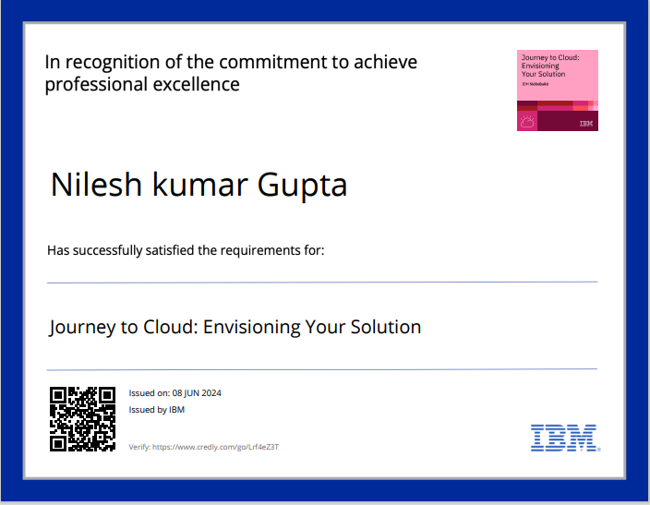
course certificate 2

Slide 13
THANK YOU

